Slide 1
Udacity Connect Session
March 24, 2018
Unsupervised Learning - Clustering
github.com/zkhundkar/ConnectIntensive/06..

Slide 2
Welcome back!

Slide 3
Morning Schedule
10:00 - 10:30 | Housekeeping, Review
10:30 - 11:00 | Unsupervised Learning - Clustering
11:00 - 11:30 | Algorithms for Clustering
11:30 - noon | Practice Notebook
© 2016 Udacity. All rights reserved.

Slide 4
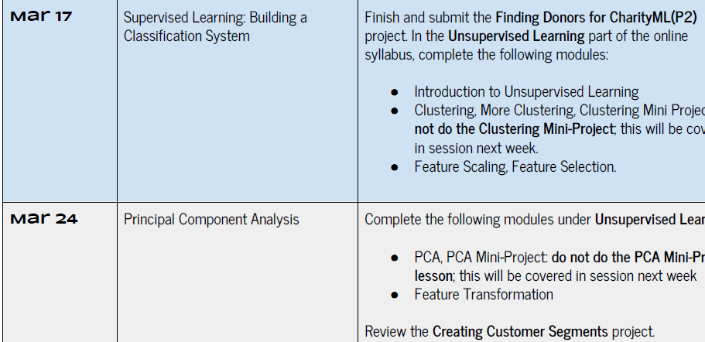

Slide 5
Review
SUPERVISED LEARNING REVIEW
Supervised Learning - Regression
Problems with continuous inputs and outputs
Linear/Multivariate Regression
Regularization
Stochastic Gradient Descent
© 2016 Udacity. All rights reserved.

Slide 6
Classification Algorithms
ML FOUNDATIONS REVIEW
Supervised Learning -- Classification
Decision Trees
KNN
Artificial Neural Networks (ANN)
Logistic/Ridge Regression
Support Vector Machines (SVM)
Probabilistic Models (Bayesian Learning)
© 2016 Udacity. All rights reserved.

Slide 7

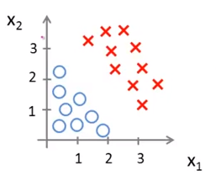
Decision Boundary
CLASSIFICATION
y = w₂x₂ + w₁x₁ + w₀
Weights define a line that best separates the classes
Doesn’t work when class distributions are not linearly separable

Slide 8
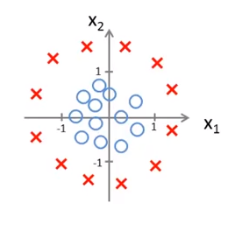
Nonlinear Decision Boundary
https://www.youtube.com/watch?v=HIQlmHxI6-0
y = w₁x₁ + w₂x₂ + w₃x₁² + w₄x₂² + w₀

Slide 9
Feature transformation
RE-ENGINEER THE VARIABLES SO THAT PROBLEM IS SIMPLIFIED
Switch (transform) to polar coordinates r, and θ
r = sqrt(x₁² + x₂²), θ = tan⁻¹(x₂/x₁)
y = w’₁r + w’₂θ + w₀ - “linearly separable”

Slide 10
Ensemble Learning
Ensemble Learning and Stacking
https://www.youtube.com/watch?v=Un9zObFjBH0
Bootstrap Aggregating https://www.youtube.com/watch?v=2Mg8QD0F1dQ
Gradient Boosting https://www.youtube.com/watch?v=GM3CDQfQ4sw&t=24s

Slide 11
Unsupervised Learning
Unlabeled data: the system gets unlabeled data and tries to group them in some way
Similar vs. dissimilar
Goal is to discover hidden “structure”
© 2017 Udacity. All rights reserved.

Slide 12
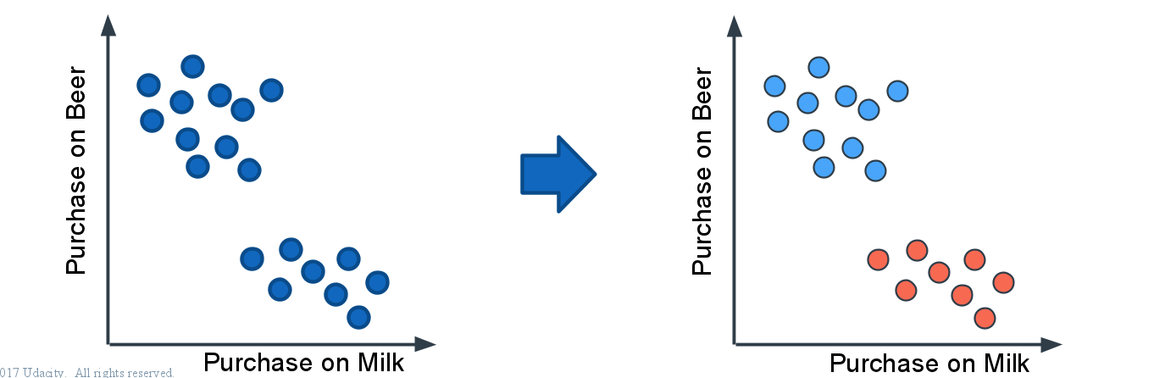
Clustering
© 2017 Udacity. All rights reserved.

Slide 13
Clustering Applications
Clustering algorithms can be applied in many fields, for instance:
Marketing: finding groups of customers with similar behavior given a large database of customer data containing their properties and past buying records;
Biology: classification of plants and animals given their features;
Libraries: books and articles classifications;
Insurance: identifying groups of motor insurance policy holders with a high average claim cost; identifying frauds;
City-planning: identifying groups of houses according to their house type, value and geographical location;
Earthquake studies: clustering observed earthquake epicenters to identify dangerous zones;
WWW: document classification; clustering weblog data to discover groups of similar access patterns.
Source: https://home.deib.polimi.it/matteucc/Clustering/tutorial_html/
© 2017 Udacity. All rights reserved.

Slide 14
Clustering Algorithms
Centroid-based - K-means (KNN)
Density-based - DBSCAN
Agglomerative (SL clustering) Expectation Maximization
Heirarchical Clustering

Slide 15
K-Means Clustering
Select N (number of clusters) to use as initial guess for cluster center. Randomly initialize N center points
Assign each point to its nearest center
Compute the new group center (as centroid)
Repeat last two steps until centers are stable

Slide 16
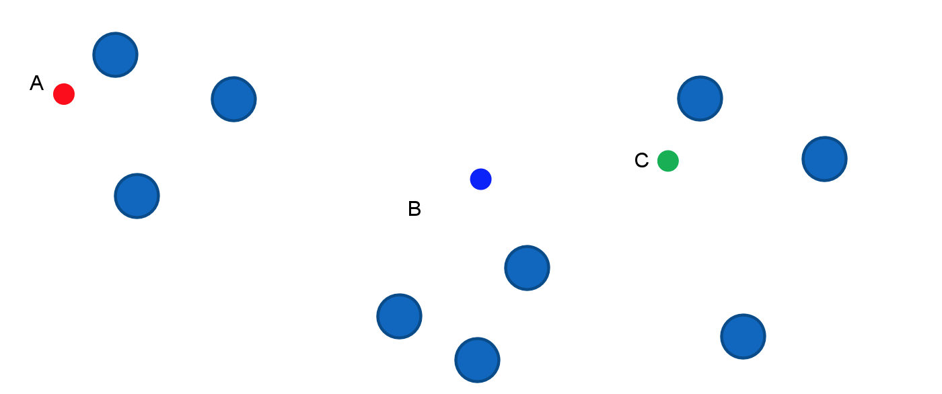
K-Means
Set N=3, then select N random points
© 2017 Udacity. All rights reserved.

Slide 17
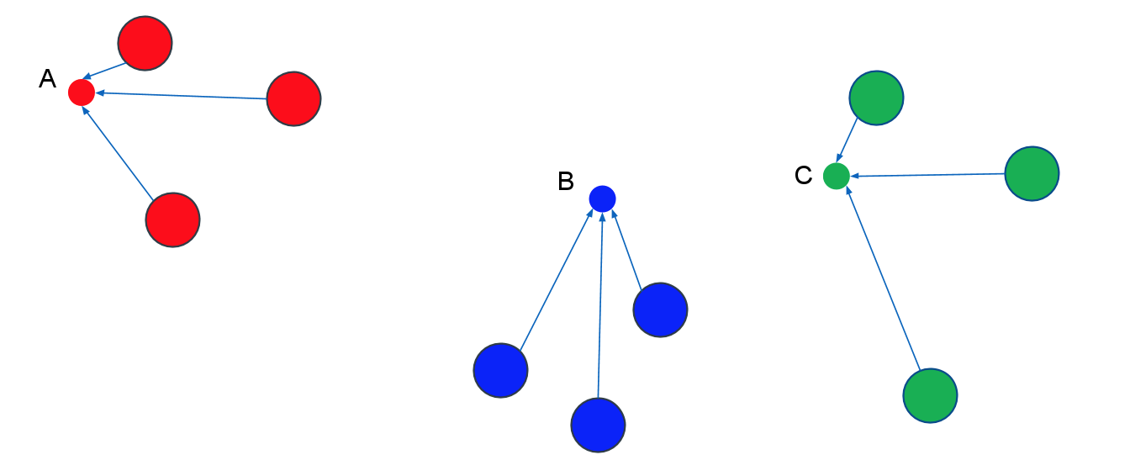
K-Means
Assign each data point to nearest cluster center
© 2017 Udacity. All rights reserved.

Slide 18
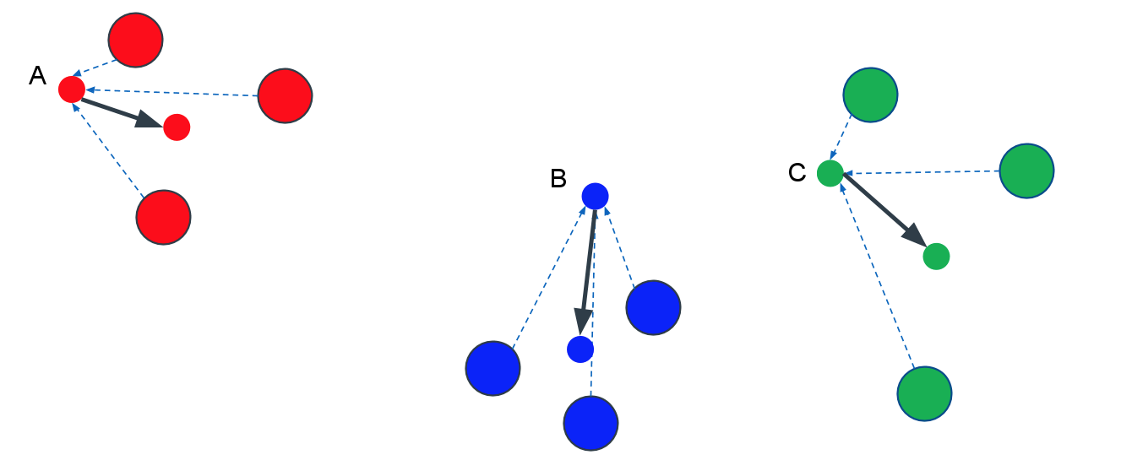
K-Means
Update: new centers = mean (centroid) of all points assigned to cluster
© 2017 Udacity. All rights reserved.

Slide 19
K-Means Clustering
ADVANTAGES
Advantages
Easy to understand and implement
General-purpose
Fast
Handles large samples well (parallelizable)

Slide 20
K-Means Clustering
Disadvantages
Have to “guess” N
Clusters could depend on initial guess (not consistent)
Hard clusters - one point is assigned to one cluster

Slide 21



Scoring
SILHOUETTE SCORE
sklearn.metrics.silhouette_score(X, labels, ..)
Mean Intra-cluster distance, a
Mean cluster distance, b
Silhouette score

Slide 22
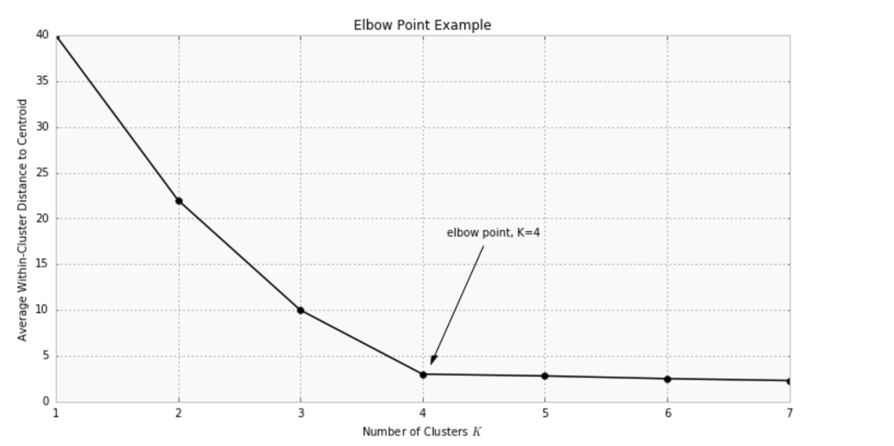
K-Means - Find the K
Find the “elbow” in score vs. number of clusters
© 2017 Udacity. All rights reserved.

Slide 23
Lunch Break

Slide 24
Afternoon Session
1:00 - 1:30 | Feature Scaling/Transformation
1:30 - 2:30 | Notebook Session
2:30 - 2:45 | Review Notebook
2:45 - 3:00 | Recap, Lookahead and Feedback
3:00 - 5:00 | Work on P2 (optionally P3)
© 2016 Udacity. All rights reserved.

Slide 25
04b NN miniproject.ipynb

Slide 26
github.com/zkhundkar/ConnectIntensive/
06 Clustering mini-project

Slide 27
Prep for next week
Complete Donors for Charity Project this week!!
Unsupervised Learning - Feature Selection, Feature Transformation, PCA
Explore 1-3 projects for your Capstone - Slack

Slide 29
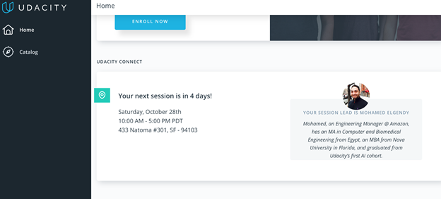
We really need your Feedback!
© 2016 Udacity. All rights reserved.

Slide 30
Title of Segue

